Slide 2
Periodic neural network Ansätze
Max Wilson, *Saverio Moroni, Arghya Bhowmik, *Filip Wudarski, *Nicholas Gao
Notes:
Too deep too fast
Cut out a lot of content
What are we trying to achieve with the presentation
Latex plotssssss

Slide 3
Wave function
Task: Learn a model of the ground state of a metallic system
...
The model must be
Periodic
Antisymmetric (fermionic)
Continuous (first- and second- order derivatives)
...
...

Slide 4
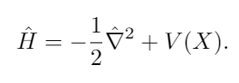
Variational Monte Carlo
Method for evolving a parameterized Ansatz toward the ground state.
Hamiltonian (kinetic + potential energy)
Evolving the Ansatz requires
Monte Carlo Sampling
Derivatives wf wrt parameters
Local energy computation
Notes:
Need a model
A way to adapt the model
Computation of the gradients and the energies

Slide 5
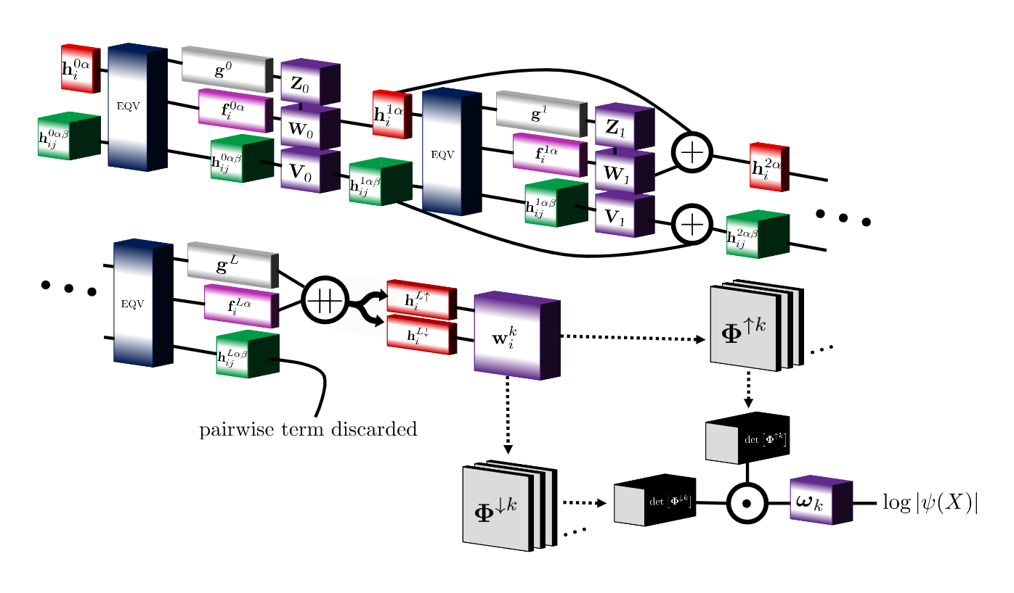
Ansatz
Not periodic inputs
Not periodic inputs
Permutation equivariant functions
Notes:
Permutation eqv functions important for antisymmetry
Will focus on the non periodic parts of the network

Slide 6
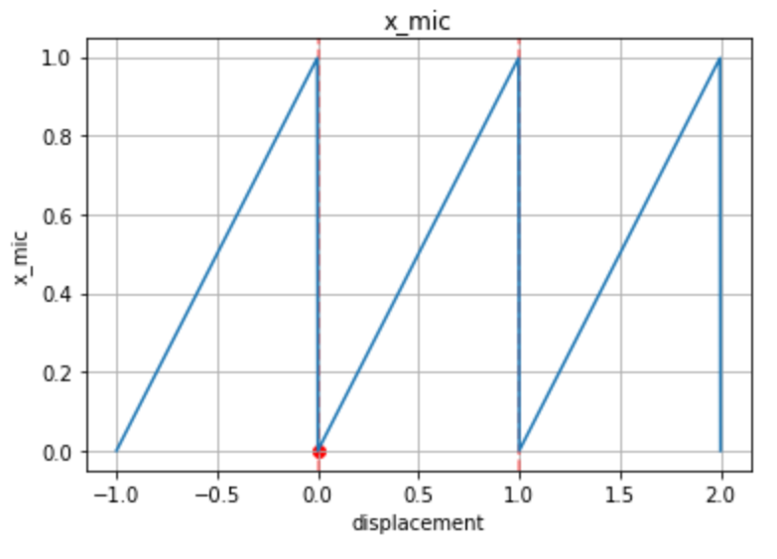
Periodic system
Simulation cell particle A
Image cell particle A

Slide 7
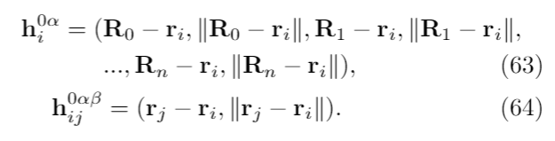
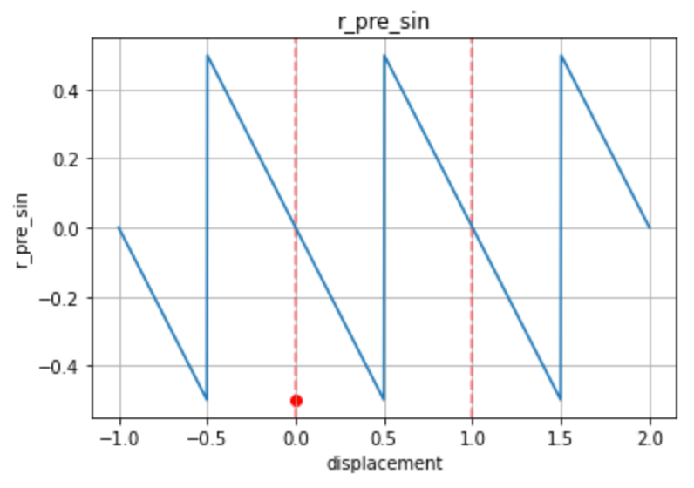
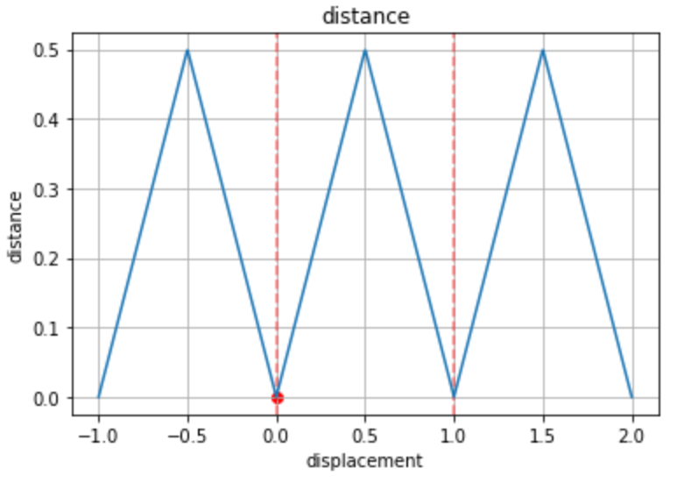
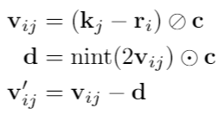
Minimum image convention
Simulation cell particle
Image cell particle

Slide 8
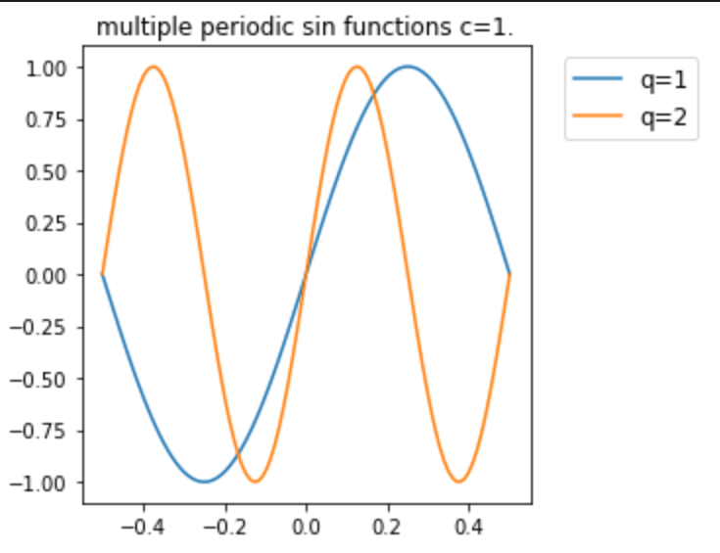
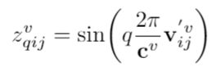
Periodic Inputs
From minimum image convention

Slide 9
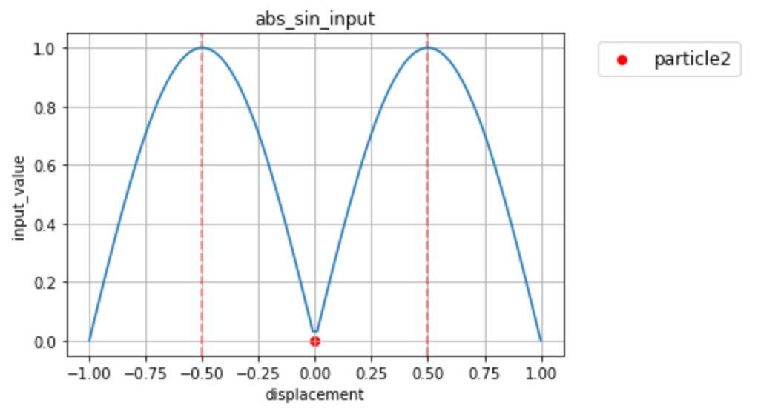
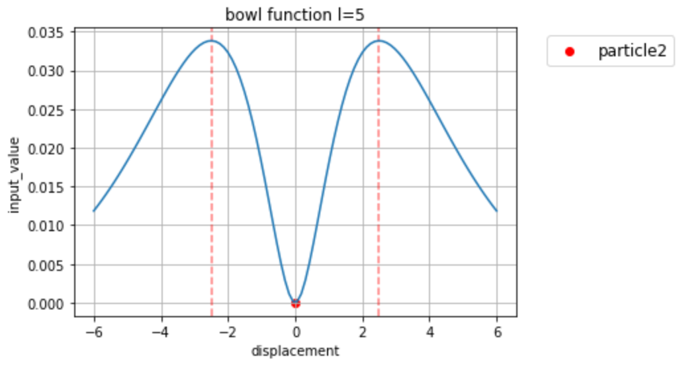
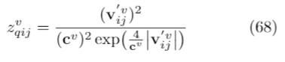
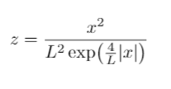
New periodic function because sin(abs(x)) not continuous?

Slide 10
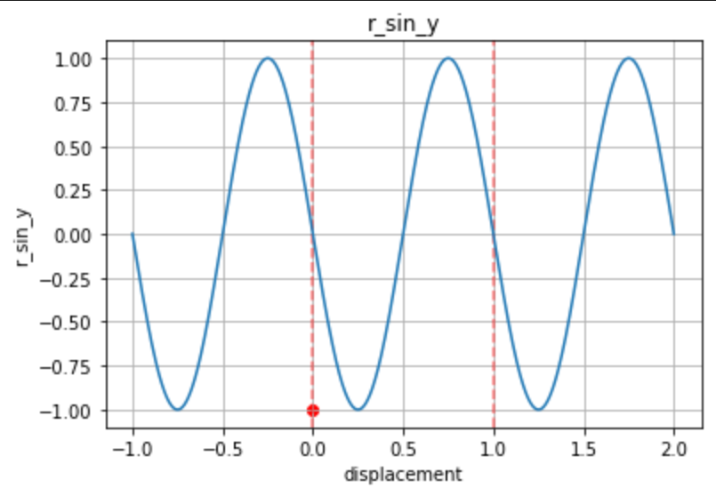

Slide 11
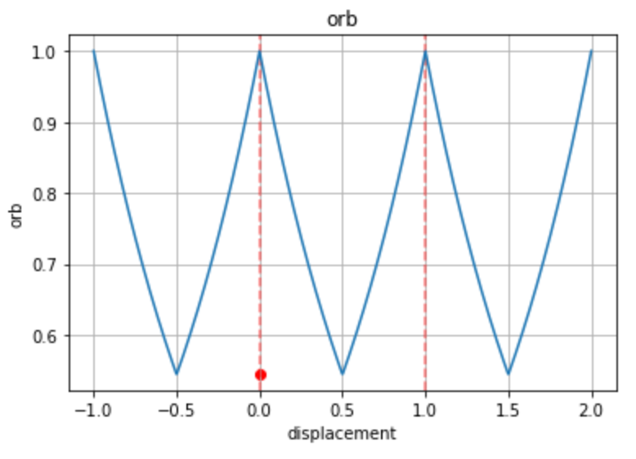
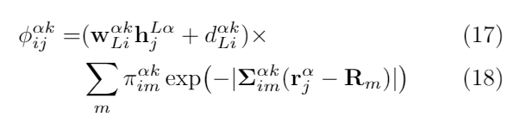
(Anisotropic) Orbitals
Discontinuity

Slide 12
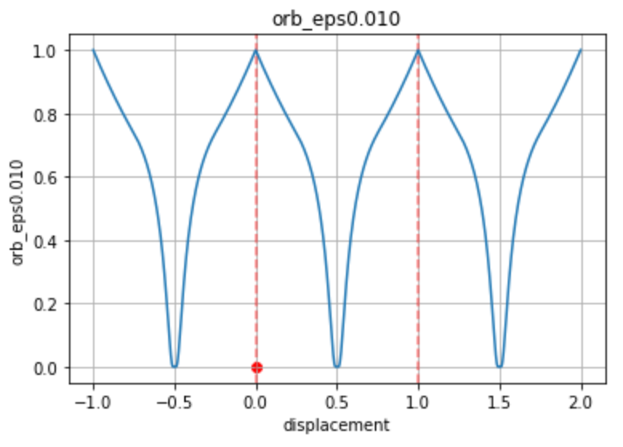
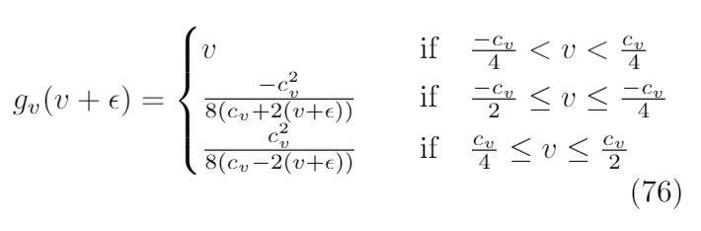
Periodic (Anisotropic) Orbitals (with \eps to stop nans)
Continuous(ish)

Slide 13
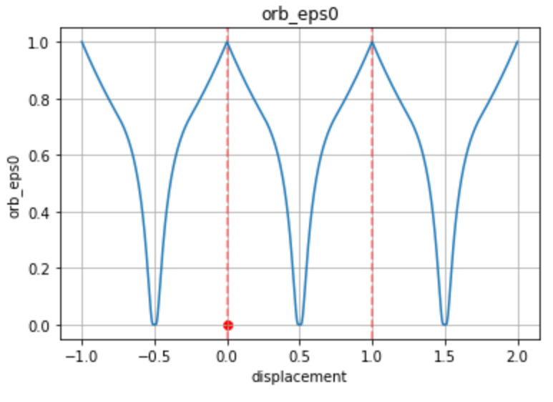
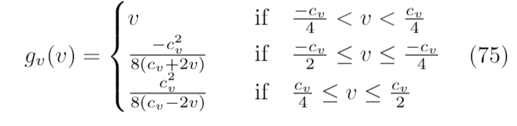
Periodic (Anisotropic) Orbitals (without \eps)
Continuous

Slide 14
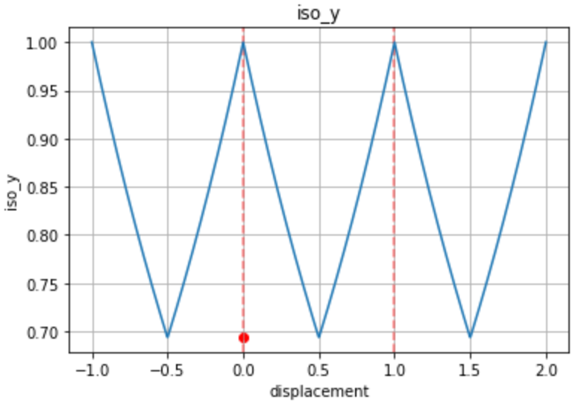
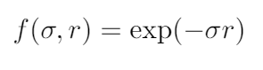
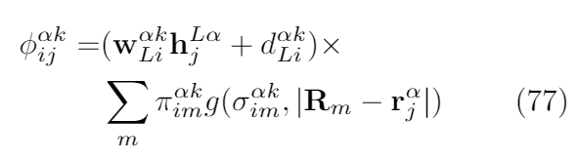
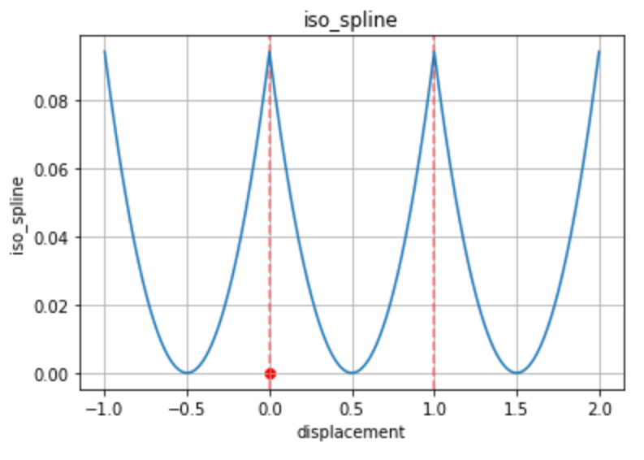
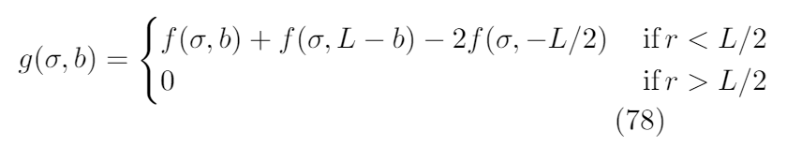
Periodic (Isotropic) Orbitals

Slide 15
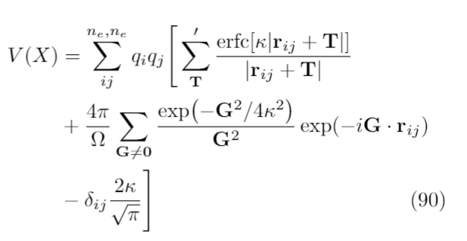
Energy computation
- Potential (Ewald’s Summation)
Real space sum
Reciprocal space sum
Self-interaction cancellation
from reciprocal space sum
Kinetic (no change to isolated case)
Compute Laplacian for all simulation cell electrons

Slide 16
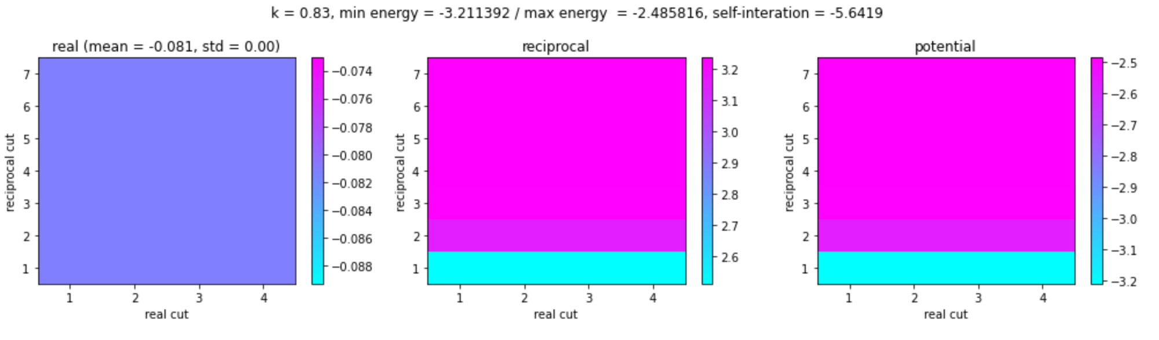
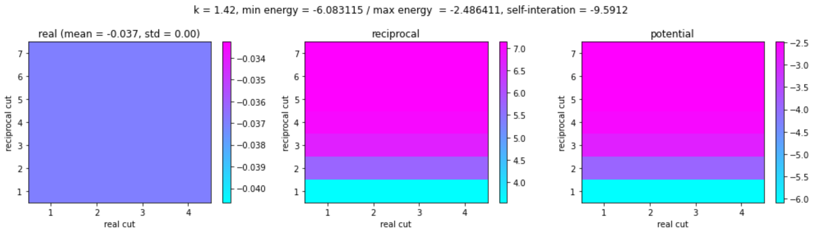
Ewald’s summation convergence

Slide 17
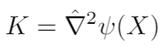
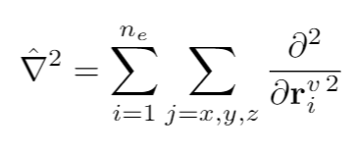
Kinetic energy

Slide 18
...
...

Slide 19
r_0
-
v_ij
nint
d
r_1
-
v’_ij
To network
r_0
-
v_ij
To network
r_1

Slide 20
Move target electron along dashed line (corner to corner)
Plot as a function of 1 dimension for ease (putting boundaries at 0.0 and unit_cell_length)
Electrons sampled randomly in 1st experiment
Electrons sampled from wave function in 2nd experiment
Place up/down electrons in path in 3rd experiment

Slide 21
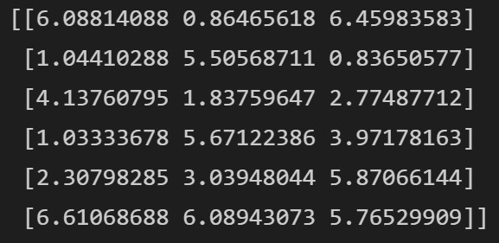
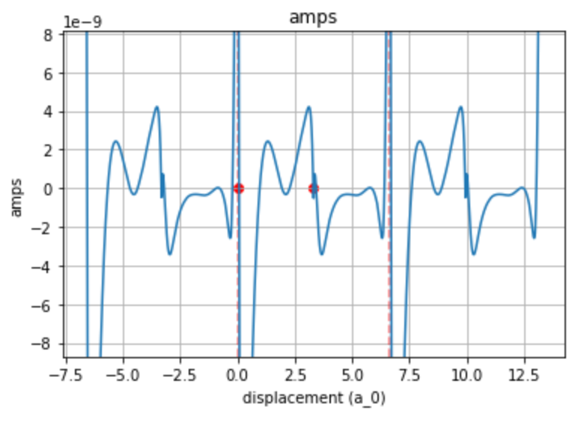
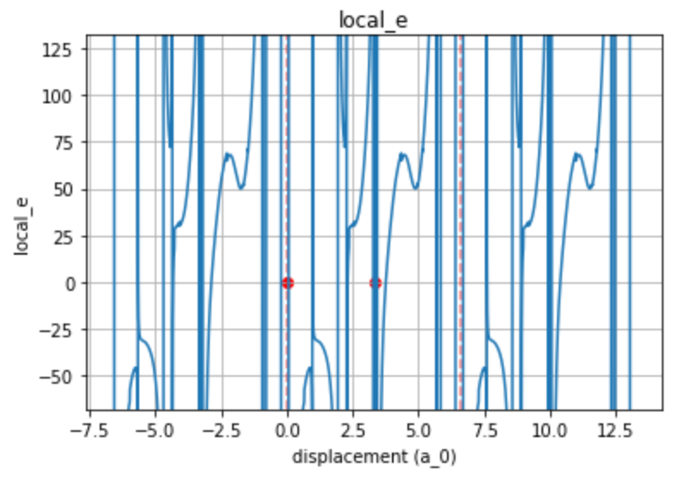
Whaddwe got? Random electrons
Not very probable (because random)

Slide 22
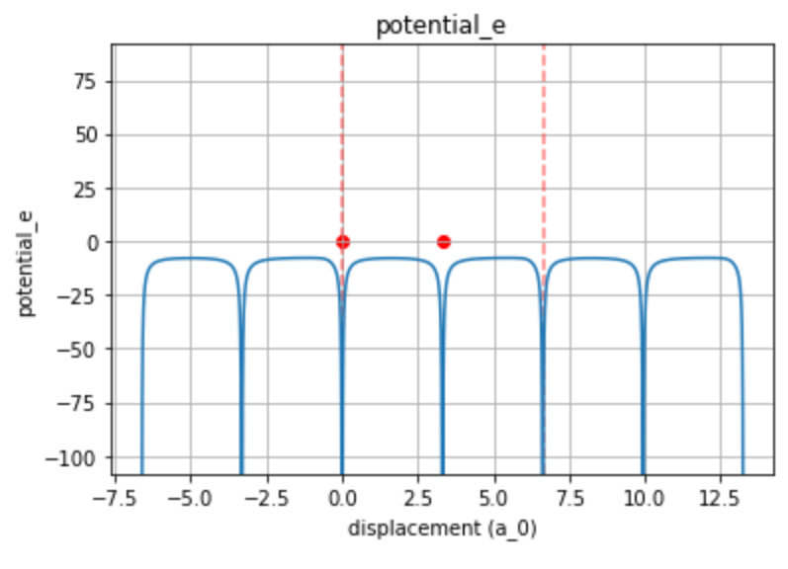
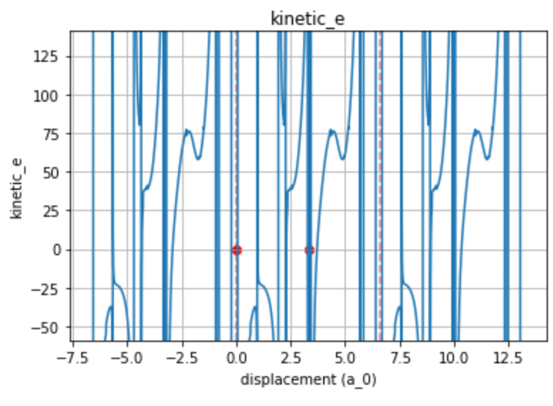

Slide 23
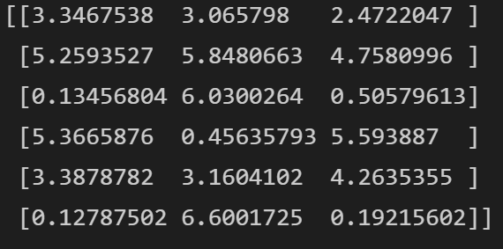
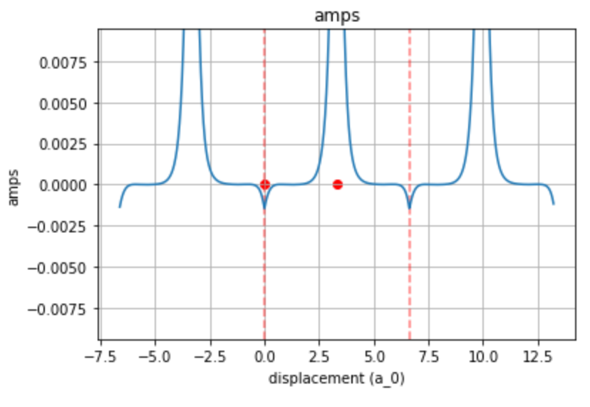
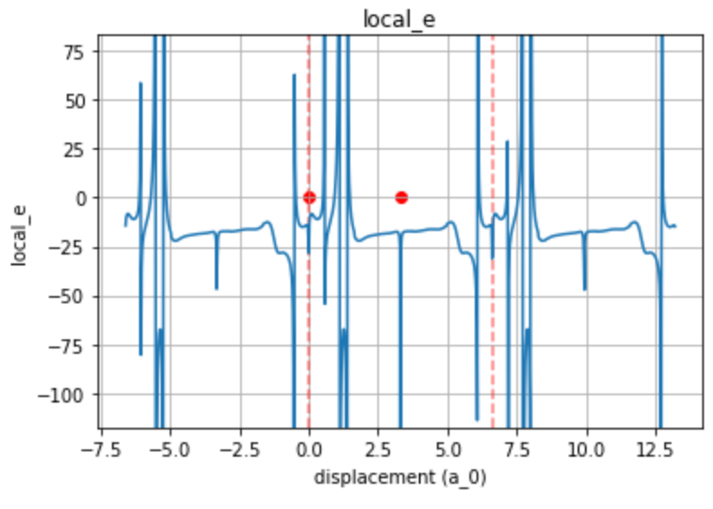
Whaddwe got? Equilibrated electrons
- First electron moved to line
- First electron moved to line

Slide 24
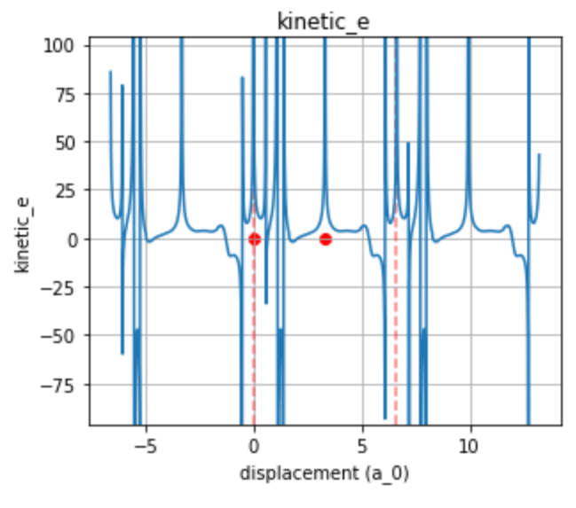
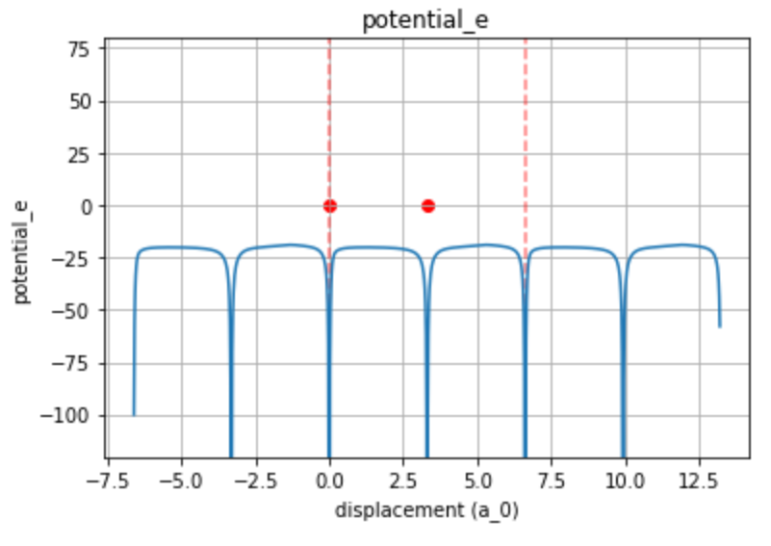

Slide 25
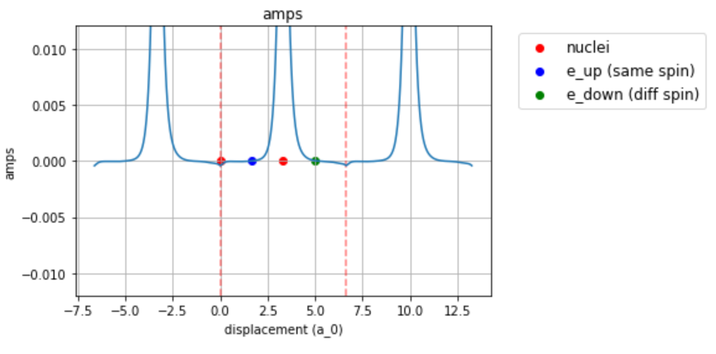
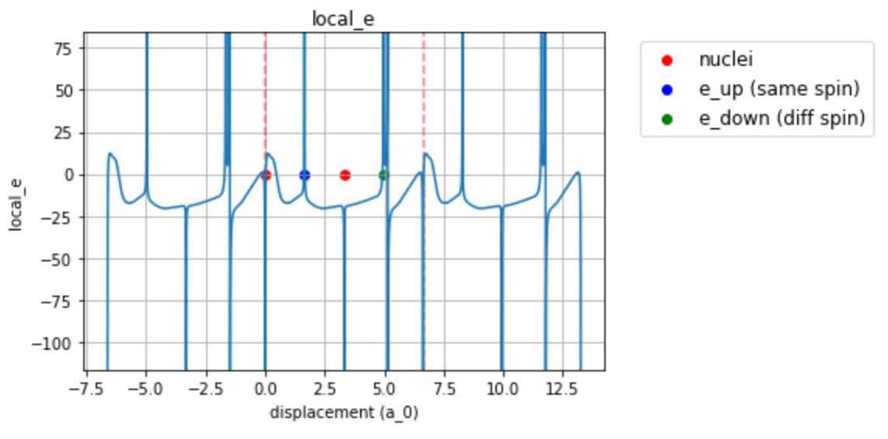
Electrons in line
First electron moved to line
Second electron moved 25% along line (between corners of cell)
Fourth electron moved 75% along line

Slide 26
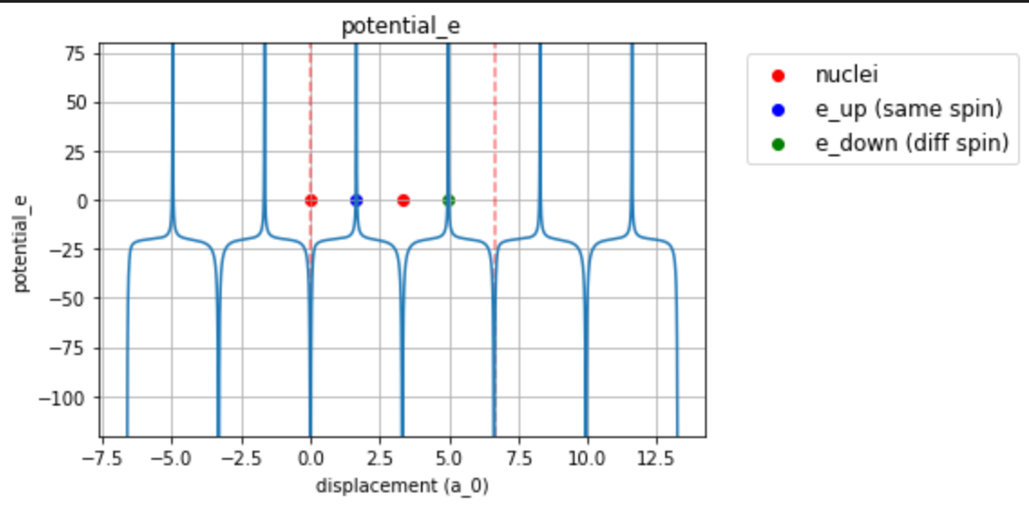
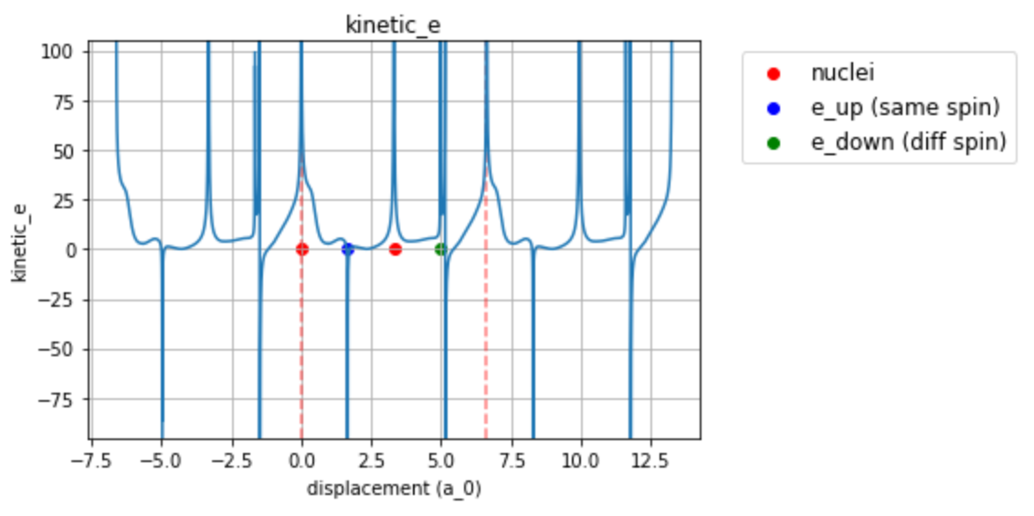

Slide 27
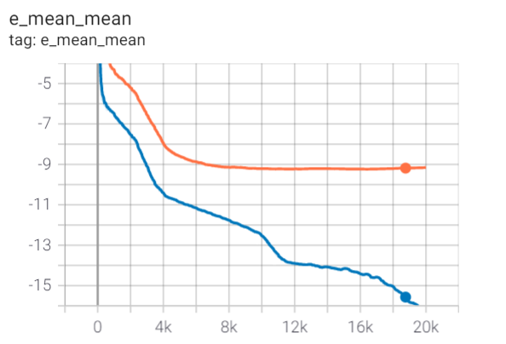
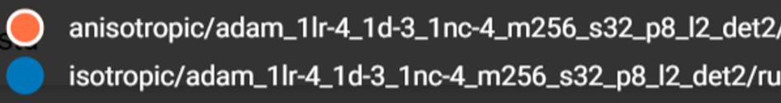

Slide 28
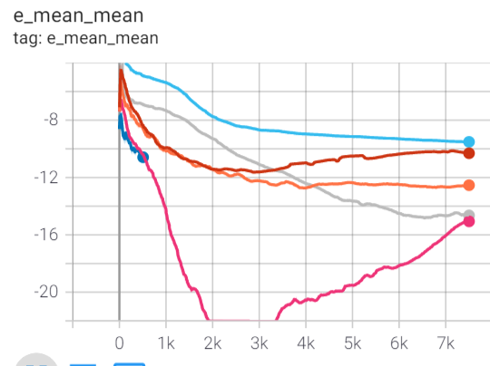
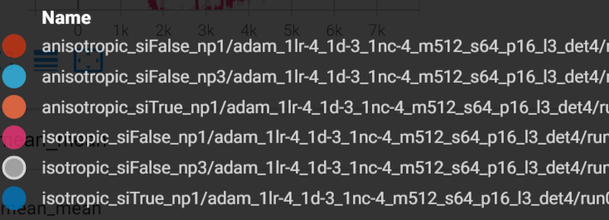
Other
Si = Scalar inputs (the inputs are reduced to the distances between particles)
Np = number periodic (the number of sin functions applied to the inputs, when the input is scalar no sin function is applied though it says np1)

Slide 29
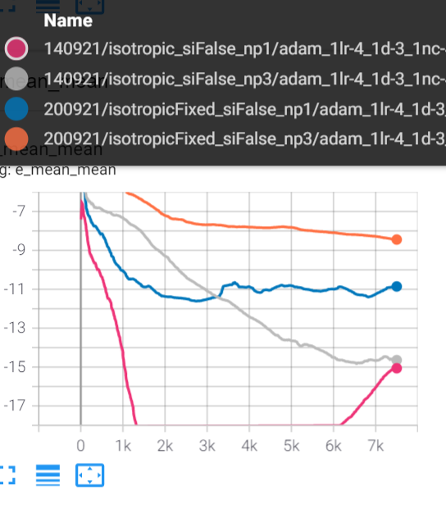

Slide 30
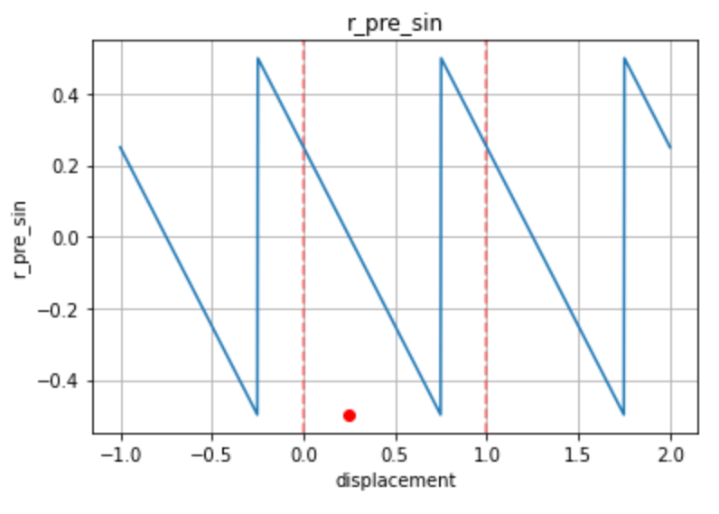



Extra: Shifted mic/inputs tests

Slide 31
11/10/21 – Project summary and plan
Current sanity checks and conclusions
Plan

Slide 32

DFT Magnitude of finite size effect
4ev = 2ev per atom = 0.075 Hartree
1-2 Hartree effect with current nn ansatz code (factor 10 off)

Slide 33


Translating the system inside the torus
...
...
...

Slide 34
Other systems
What we can’t do
We can’t scale to Lithium 2x2x2 yet (8 x 2 x 3 = 48 electrons)
What we could do
Implement primitive cell implementation with vector space transforms scale to 2x2x2 (for Li 24 electrons)
Insulators (Lithium hydride, lithium fluoride)
Other structures (What do you recommend?)
Electron gas

Slide 35


Electron gas

Slide 36
Things that need to/can be done
Back to non-orthorhombic primitive cell design (transforming vector spaces) and scale
Alternate systems that scale easier with orthorhombic cell design
Scale to n > 1 nodes
KFAC adjustments
HF orbitals from 3rd party code (pretraining)
Electron gas
Ansatz design (orbital structure)
Scaling
Spin polarized / non spin polarized
What is the finite size effect for one unit cell QMC? (CASINO, Saverio)
What is the finite size effect of the Ewald’s sum
Can we force the orbitals to zero?

Slide 37


HEG

Slide 38

HEG Hamiltonian

Slide 39

HEG

Slide 40
24/10/21 Todoish
Slater-Jastrow neural network Ansatz
Complex orbital plane wave nn Ansatz
QMC baselines (CASINO)
Scale to RTX 3090s
Scale to >1 nodes (max out system size)

Slide 41


PDF sum over electrons and not including MIC

Slide 42

PDF sum over electrons including MIC

Slide 43


PDF single electron not including MIC

Slide 44

PDF single electron including MIC

Slide 45

Adam vs kfac shifted to exaggerate difference

Slide 46


Density sweep

Slide 47


Parameter ablation HEG

Slide 48

Det ablation Li

Slide 49

Li nonlin

Slide 50

Inact nonlin Li

